Slide 1
BigQuery Performance & Cost Optimization
Mohit Kaushik

Slide 2

Challenges Before Optimization
Previously, if we had eight files in a catalog, we needed to run the model eight separate times—once for each file.
This process was time-consuming and costly, as each execution incurred additional charges.
Manually running the model multiple times increased human effort and the likelihood of errors.

Slide 3
Optimized Solution & Implementation
With the new optimization:
The model now runs once for all eight catalogs instead
of eight separate runs.
Data from all files is fetched in a single execution, eliminating
redundant processing.

Slide 4
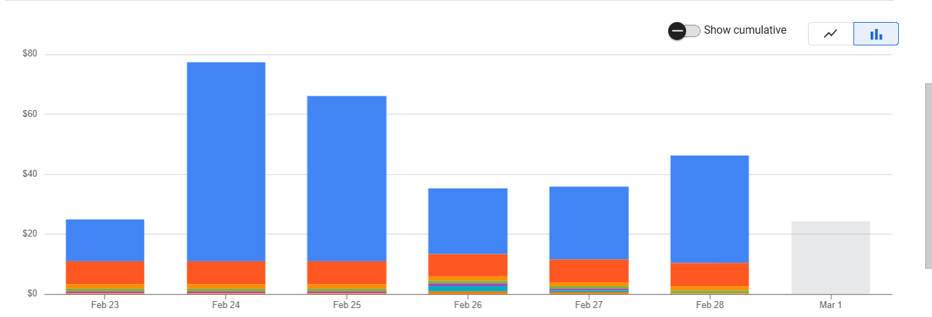
Key Benefits & Impact
1️⃣ Reduced Error Rate
No need to manually retrieve the URI from GCP multiple times.
Eliminates the risk of selecting the wrong catalog or accidentally extracting duplicate data.
2️⃣ Cost Savings
Previously, running the model for eight catalogs cost $40 (assuming $5 per execution).
Now, with a single execution, the cost is reduced to just $5, resulting in significant savings.

Slide 5
3️⃣ Optimized Google Storage Usage
Earlier, we created separate object tables for each catalog, consuming unnecessary storage.
Now, all data is stored in a single object table, optimizing storage and
allowing us to keep more data within the same space.
4️⃣ Fully Automated Process
The system automatically creates a separate table for each catalog and consolidates all extracted data into one final table.
5️⃣ Handling Complex Hierarchies
The new approach allows us to deal with more intricate hierarchy
structures and flag-based data processing with ease.

Slide 6
Future Enhancements & Scalability
Looking ahead, we aim to further enhance the process by:
Scaling the system to extract data from all brands together, making it even more efficient.
Final Thoughts
With this project, we have significantly improved efficiency, accuracy, and cost-effectiveness. Moving forward, we will continue refining the approach to handle even larger datasets with minimal manual effort.

